Slide 1
POINTERS WITH FUNCTION

Slide 2
Outline
Passing pointer to a Function
Pointer and one dimensional Array

Slide 3
Introduction
There are two ways to pass arguments to a function
  call-by-value and
  call-by-reference.
All arguments in C are passed by value.
Return may be used to return one value from a called function to a caller (or to return control from a called function without passing back a value).
Many functions require the capability to modify one or more variables in the caller or to pass a pointer to a large data object to avoid the over- head of passing the object by value.

Slide 4
Calling Functions by Reference
Pointer arguments are used in call by reference.
When we pass a pointer as an argument instead of a variable, then the address of the variable is passed instead of the value. So any change made by the function using the pointer is permanently made at the address of passed variable. This technique is known as call by reference in C.

Slide 5
Calling Functions by Reference
When the address of a variable is passed to a function, the indirection operator (*) may be used in the function to modify the value at that location in the caller’s memory.
* operator
  Used as alias/nickname for variable inside of function
      void double( int *number ) {
      *number = 2 * ( *number );
      }
  *number used as nickname for the variable passed

Slide 6
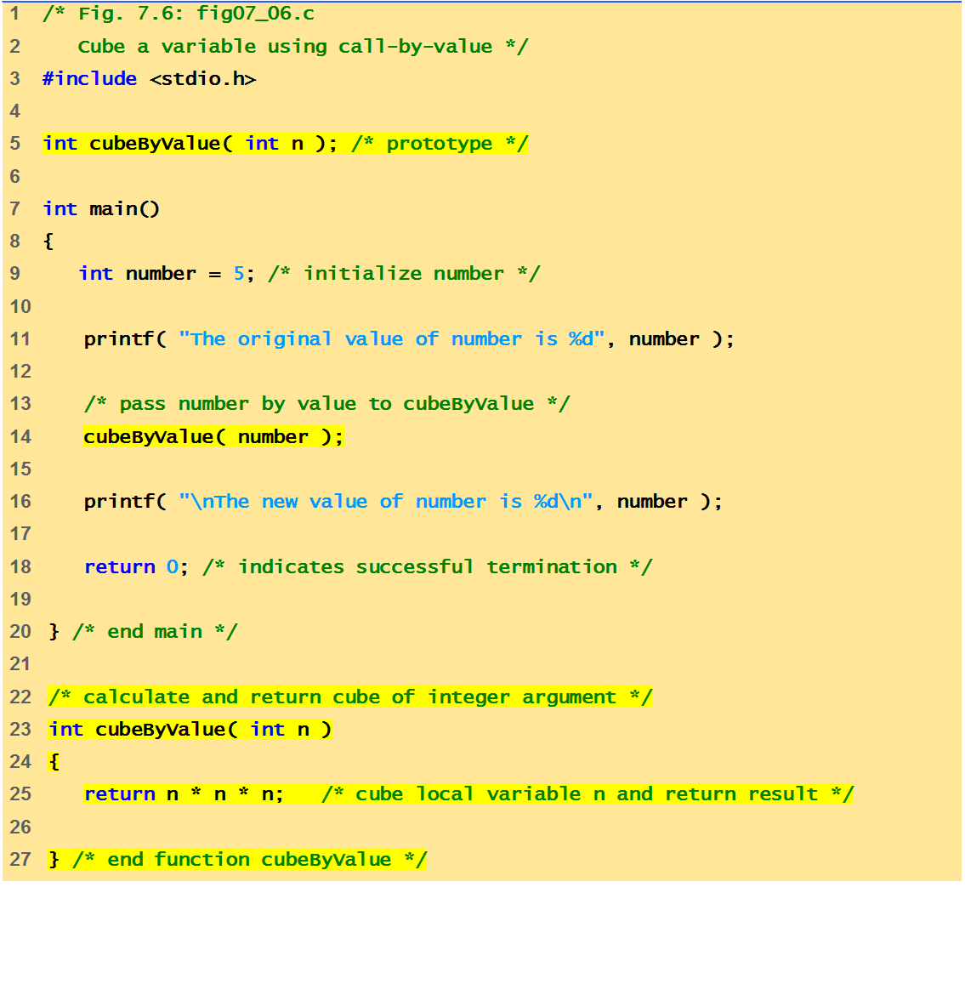
Program to call function by value
The original value of number is 5
The new value of number is 125

Slide 7
Before function call
int
main()
number
int
cubeByValue(
int
n )
{
{
int
number =
5
5
;
return
n * n * n;
}
cubeByValue(number);
n
}
undefined
After function receives call
int
main()
number
int
cubeByValue(
int
n )
{
{
int
number =
5
;
5
return
n * n * n;
}
cubeByValue( number );
n
}
5
After function computes n and before it returns to main
int
main()
number
int
cubeByValue(
int
n )
{
{
125
int
number =
5
;
5
return
n * n * n;
}
cubeByValue( number );
n
}
5
Fig. Analysis of a typical call-by-value. (Part 1 of 2.)

Slide 8
After function returns to main and before assigning result to number
int
main()
number
int
cubeByValue(
int
n )
{
{
int
number =
5
5
;
return
n * n * n;
125
}
number = cubeByValue( number );
n
}
undefined
After main completes the assignment to number
:
int
main()
number
int
cubeByValue(
int
n )
{
{
int
number =
5
;
125
return
n * n * n;
125
125
}
number = cubeByValue( number );
n
}
undefined

Slide 9
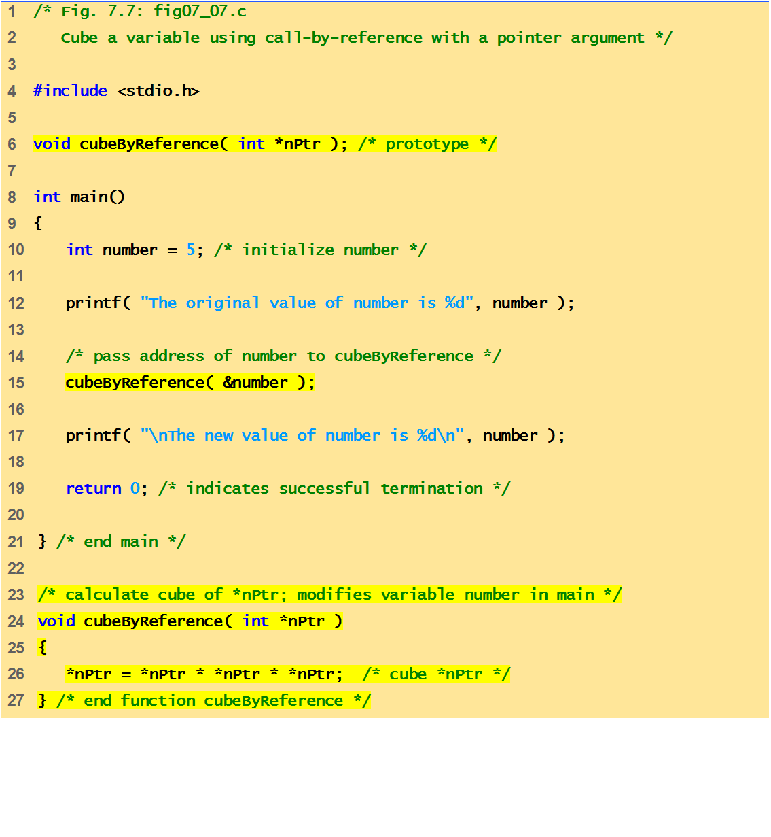
Notice that the function prototype takes a pointer to an integer.
Program to call a function by reference.
Notice how the address of number is given - cubeByReference expects a pointer (an address of a variable).
Inside cubeByReference, *nPtr is used (*nPtr is number).
The original value of number is 5
The new value of number is 125

Slide 10
Before function call
int
main()
number
void
cubeByReference(
int
*nPtr )
{
5
{
int
number =
5
;
*nPtr = *nPtr * *nPtr * *nPtr;
}
cubeByReference( &number );
nPtr
}
undefined
After function receives the call and before function computes
int
main()
number
void
cubeByReference(
int
*nPtr )
{
5
{
int
number =
5
;
*nPtr = *nPtr * *nPtr * *nPtr;
}
cubeByReference( &number );
nPtr
}
call establishes this pointer
After *nptr is cubed and before program control returns to main
:
int
main()
number
void
cubeByReference(
int
*nPtr )
{
125
{
125
int
number =
5
;
*nPtr = *nPtr * *nPtr * *nPtr;
}
cubeByReference( &number );
called function modifies
caller’s variable
nPtr
}
Fig. Analysis of a typical call-by-reference with a pointer argument.

Slide 11
Relationship Between Pointers and Arrays
Arrays and pointers are closely related.
  Array name is like a constant pointer
  Pointers can do array subscripting operations
Define an array b[5] and a pointer bPtr.
  To set bPtr so as to point to b[5]:
      bPtr = b;
    The array name (b) is actually the address of first element of the array b[5] which is equivalent to
      bPtr = &b[0]
    Explicitly assigns bPtr to address of first element of b

Slide 12
Relationship Between Pointers and Arrays
  Element b[3]
    Can be accessed by *(bPtr + 3)
      Where 3 is the offset. Called pointer/offset notation
    Can be accessed by bptr[3]
      Called pointer/subscript notation
      bPtr[3] same as b[3]
    Can be accessed by performing pointer arithmetic on the array itself
      *(b + 3)

Slide 13
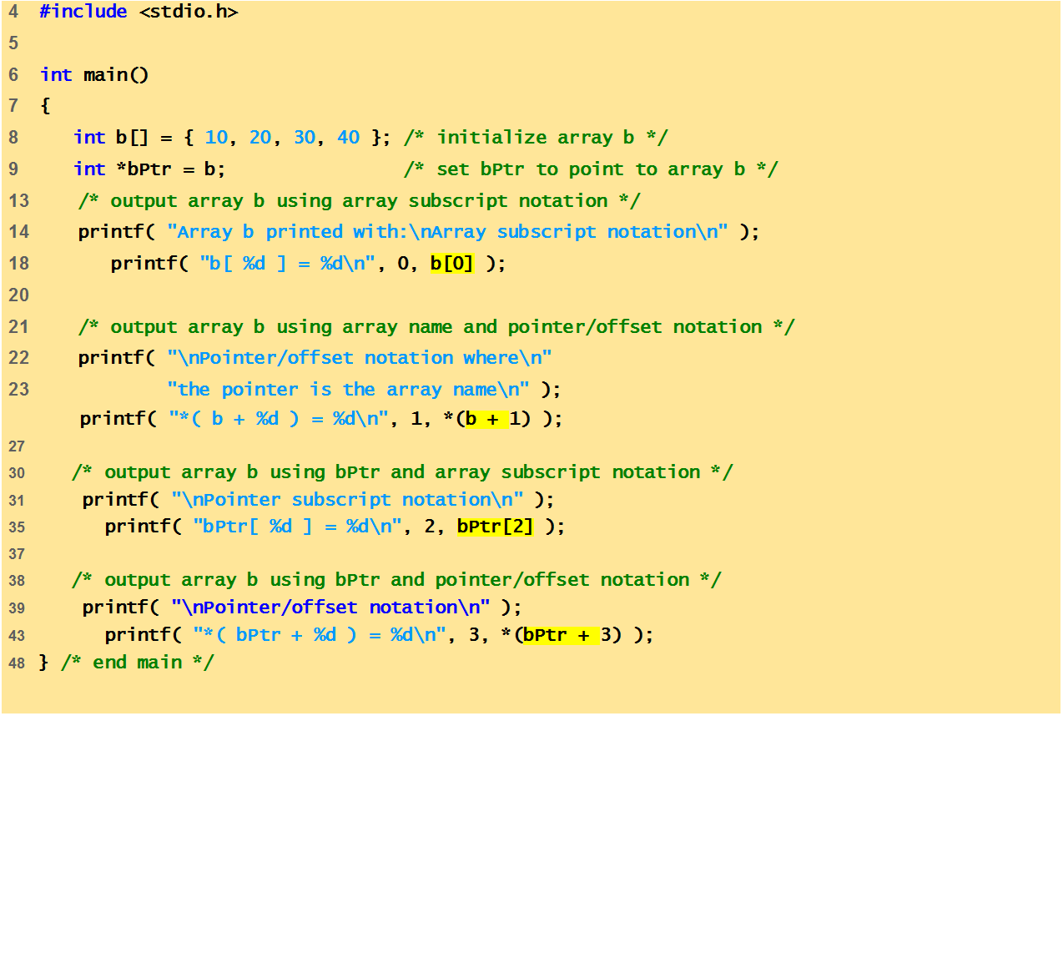
Program to show subscripting and pointer notation with 1- D arrays.

Slide 14
Array b printed with:
Array subscript notation
b[ 0 ] = 10
Pointer/offset notation where
the pointer is the array name
*( b + 1 ) = 20
Pointer subscript notation
bPtr[ 2 ] = 30
Pointer/offset notation
*( bPtr + 3 ) = 40

Slide 15
Character arrays and pointers
What’s the difference between char s1[] and char* s2?
char s1[] = “hello”
char* s2 = “hello”
The first one is a character array , because of the empty brackets. Also the compiler counts the number of characters/letters plus the terminating null to mark the end of the string.
The second is a character pointer that points to type char.
s1 is a pointer variable: it stores the address of the array it points to.
But s2 is a fixed pointer constant, that is its address can't be changed. It is not a pointer variable.

Slide 16
Difference between Array and Pointer
Basis For Comparison | ARRAY | POINTER
Declaration | datatype array_name[size]; Eg: int arr[100]; | datatype * var_name; Eg: int *ptr;
Working | Stores the value of the variable of homogeneous datatype. | Store the address of the another variable of same datatype as the pointer variable's datatype.
Generation | An array of pointers can be generated. | A pointer to an array can be generated.
Storage | A normal array stores values of variable and pointer array stores the address of variables. | Pointers are specially designed to store the address of variables.
Capacity | An array can store the number of elements, mentioned in the size of array variable. | A pointer variable can store the address of only one variable at a time.

Slide 17
Next Class: Array of pointers

